Slide 1
SHA 3 Algorithm
Mohamed Reda

Slide 2
Cryptographic hash function
is a special class of hash function that has certain properties which make it suitable for use in cryptography. It is a mathematical algorithm that maps data of arbitrary size to a bit string of a fixed size (a hash function) which is designed to also be a one-way function, that is, a function which is infeasible to invert.

Slide 3
Secure Hash Algorithm 3
a subset of the cryptographic primitive family Keccak , is a cryptographic hash function designed by Guido Bertoni, Joan Daemen, Michaël Peeters, and Gilles Van Assche, building upon RadioGatún. SHA-3 is a member of the Secure Hash Algorithm family.

Slide 4
Keccak
Keccak is a family of sponge functions. The sponge function is a generalization of the concept of cryptographic hash function with infinite output and can perform quasi all symmetric cryptographic functions, from hashing to pseudo-random number generation to authenticated encryption.

Slide 5
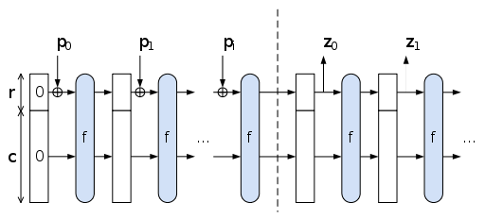
The Sponge Construction: Used by SHA-3
Each round, the next r bits of message is XOR’ed into the first r bits of the state, and a function f is applied to the state.
After message is consumed, output r bits of each round as the hash output; continue applying f to get new states
SHA-3 uses 1600 bits for state size

Slide 6
Well Known Hash Functions
MD5
output 128 bits
collision resistance completely broken by researchers in China in 2004
SHA1
output 160 bits
no collision found yet, but method exist to find collisions in less than 2^80
considered insecure for collision resistance
one-wayness still holds
SHA2 (SHA-224, SHA-256, SHA-384, SHA-512)
outputs 224, 256, 384, and 512 bits, respectively
No real security concerns yet

Slide 7
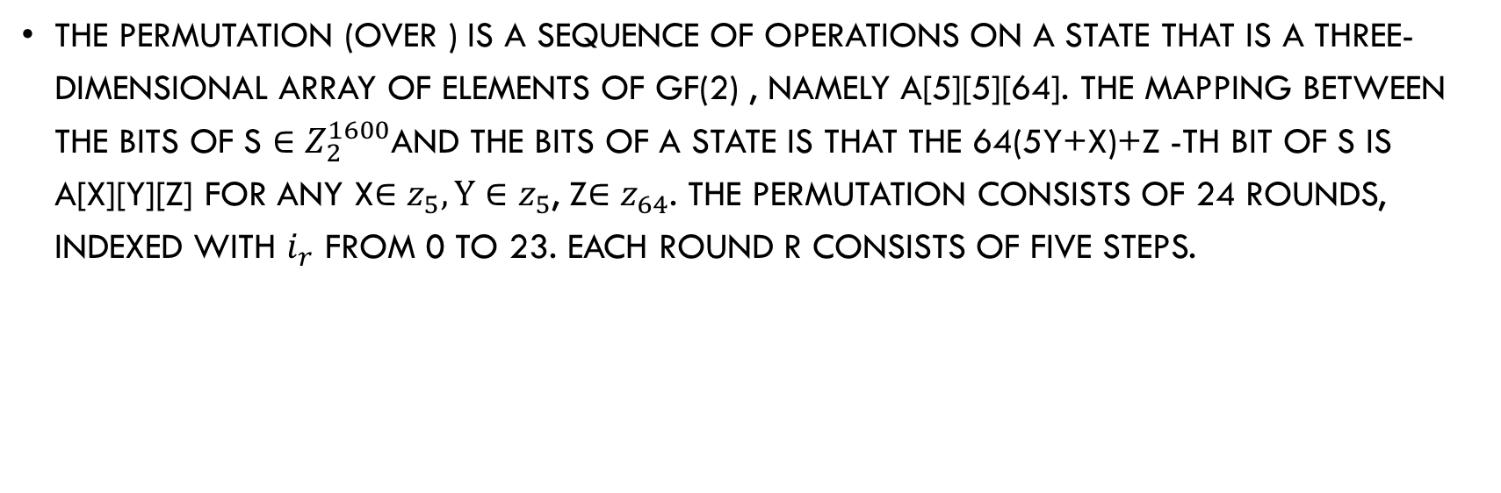
Steps of SHA 3
The permutation (over ) is a sequence of operations on a state that is a three-dimensional array of elements of GF(2) , namely a[5][5][64]. The mapping between the bits of s $∈$ $Z_{2}^{1600}$and the bits of a state is that the 64(5Y+x)+z -th bit of s is a[x][y][z] for any x$∈$ $z_{5},y∈$ $z_{5}$, z$∈$ $z_{64}$. The permutation consists of 24 rounds, indexed with $i_{r}$ from 0 to 23. Each round R consists of five steps.

Slide 8
Steps of SHA 3

Slide 9
Limitation of Using Hash Functions for Authentication
Require an authentic channel to transmit the hash of a message
Without such a channel, it is insecure, because anyone can compute the hash value of any message, as the hash function is public
Such a channel may not always exist
How to address this?
use more than one hash functions
use a key to select which one to use

Slide 10
References
https://en.wikipedia.org/wiki/Cryptographic_hash_function
https://en.wikipedia.org/wiki/SHA-3
http://keccak.noekeon.org/

